Slide 1
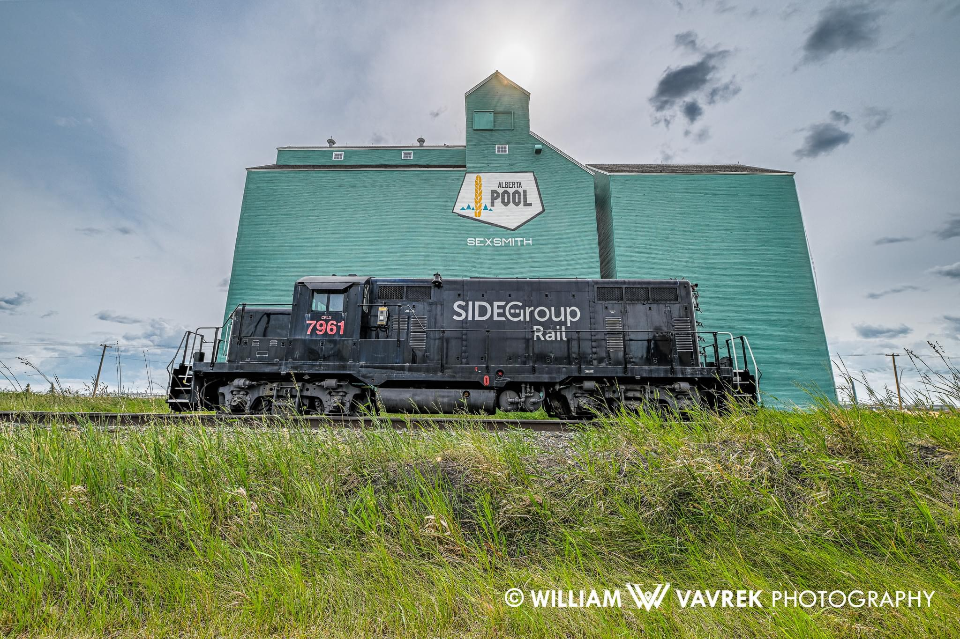
SEXSMITH TRAIN PROJECT
Sexsmith & District Museum Society​

Slide 2
Agenda
A
Introduction
Project Phases
Timeline
County & Community Benefits
Summary

Slide 3
Introduction
The Sexsmith & District Museum Society is comprised of long term members with extensive historical knowledge and a dedicated group of volunteers with a passion for history.
The society consists of 40 active members and volunteers.
The museum received 2264 registered visitors from May 1 – Sept. 3, 2023. The visitors included people from the Peace Country, as well as tourists from around the world. The museum also hosted numerous groups and tours, including: The Playwright Symposium, choreographed movie street fighters, social events, 5 school tours, 8 elevator tours, Chautauqua Day, An Art walk, 3 blacksmith classes, wedding photo shoots and Communities in Bloom appreciation lunch.
There are 2 long-term renters in the N.A.R. Train Station. We also have rental space in the Old Fire Hall for small events, as well as the Greek Orthodox Church and Emmanuel Anglican Church for weddings and services.

Slide 4
Vision, Mission and Value Statements
Vision
To connect, communicate, and impart historical knowledge focusing on the significance of our past In Sexsmith and area, with all people, young and old alike.
Mission
To acquire, conserve, research, communicate and exhibit for the purpose of study, education and enjoyment, the material evidence of the history of people and their environment in the Sexsmith area.
Value
We are guided by our values of integrity, stewardship, respect for people, pursuit of excellence and continuous learning.
Our efforts are fueled by our love of history, curiosity, creativity, collaboration and accomplishment.

Slide 5
Project Phases

Slide 6
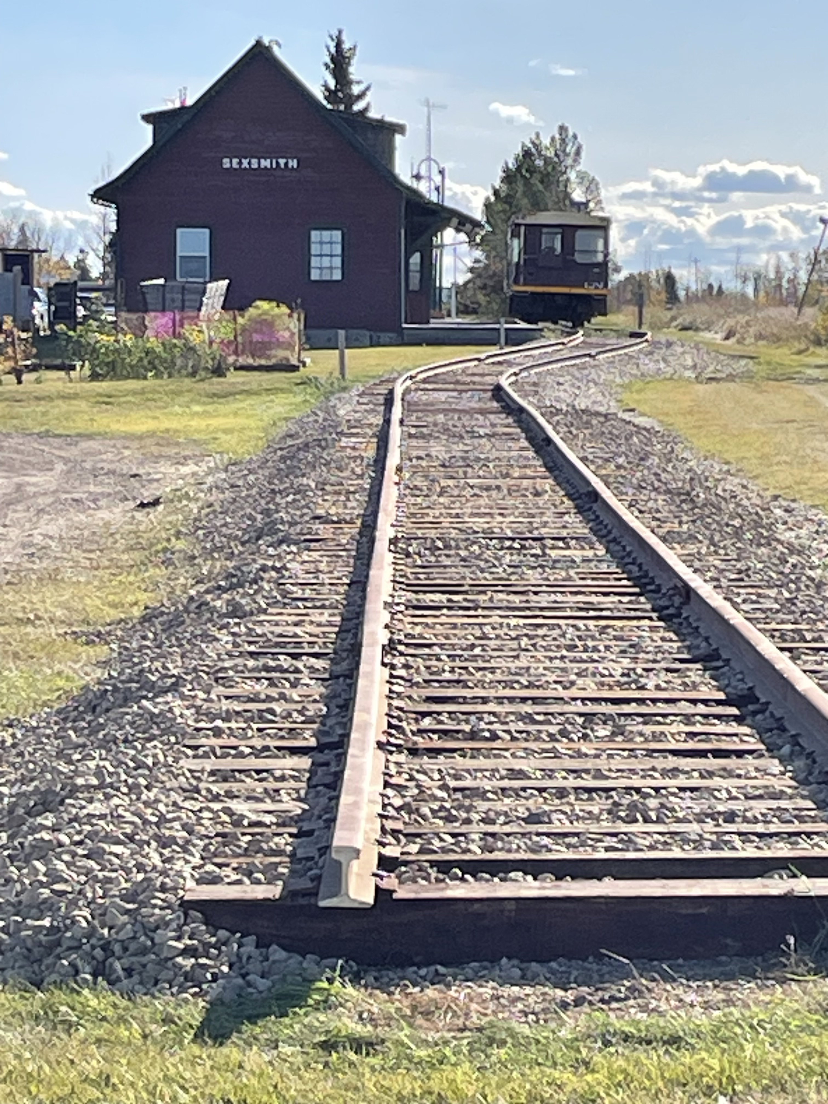
Phase 1
The project was initiated with the donation of a 1953 GP7 diesel locomotive from Al Side (The Side Group) in 2021.
With this donation, preparations were made to extend the side rail next to the historic Alberta Wheat Pool grain elevator and train station.
A group of enthusiastic community minded folks donated their time and resources to make this possible.
Total Cost: $ 169,106.88
Total donations for Phase 1: $168,394.98

Slide 7
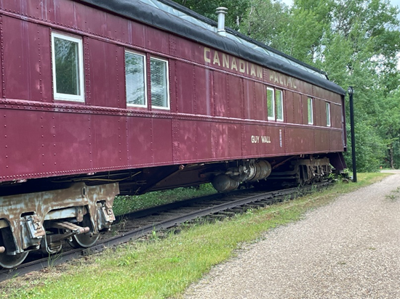
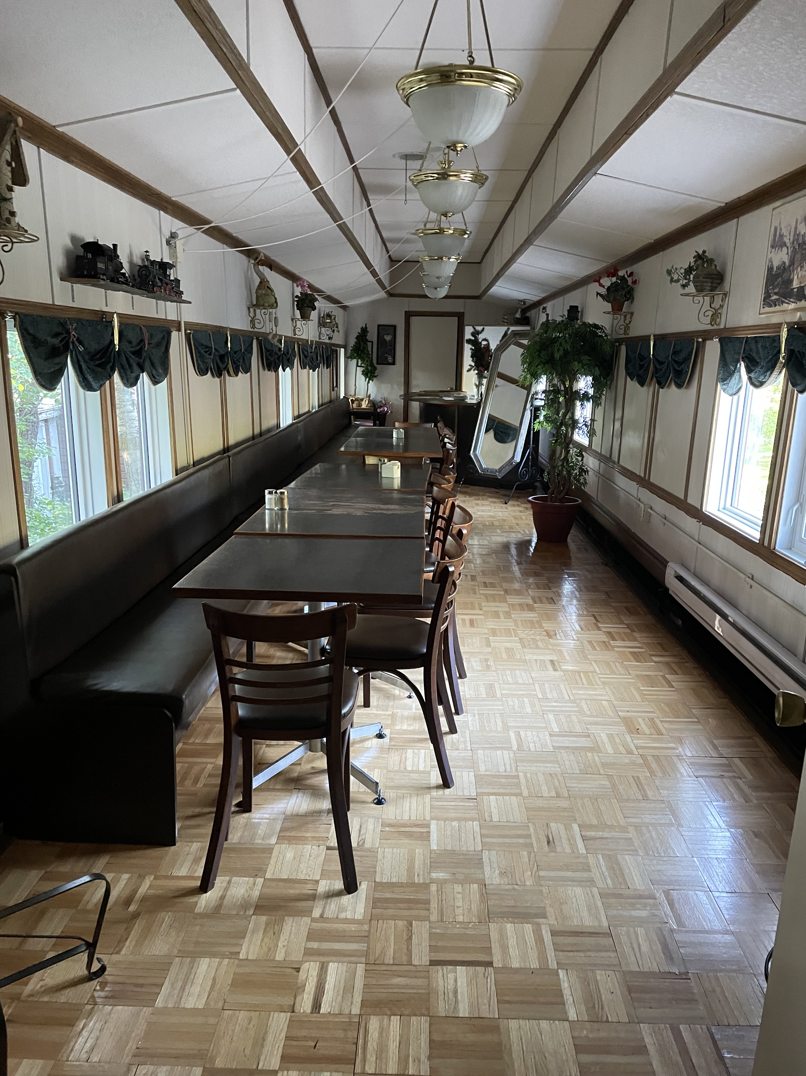
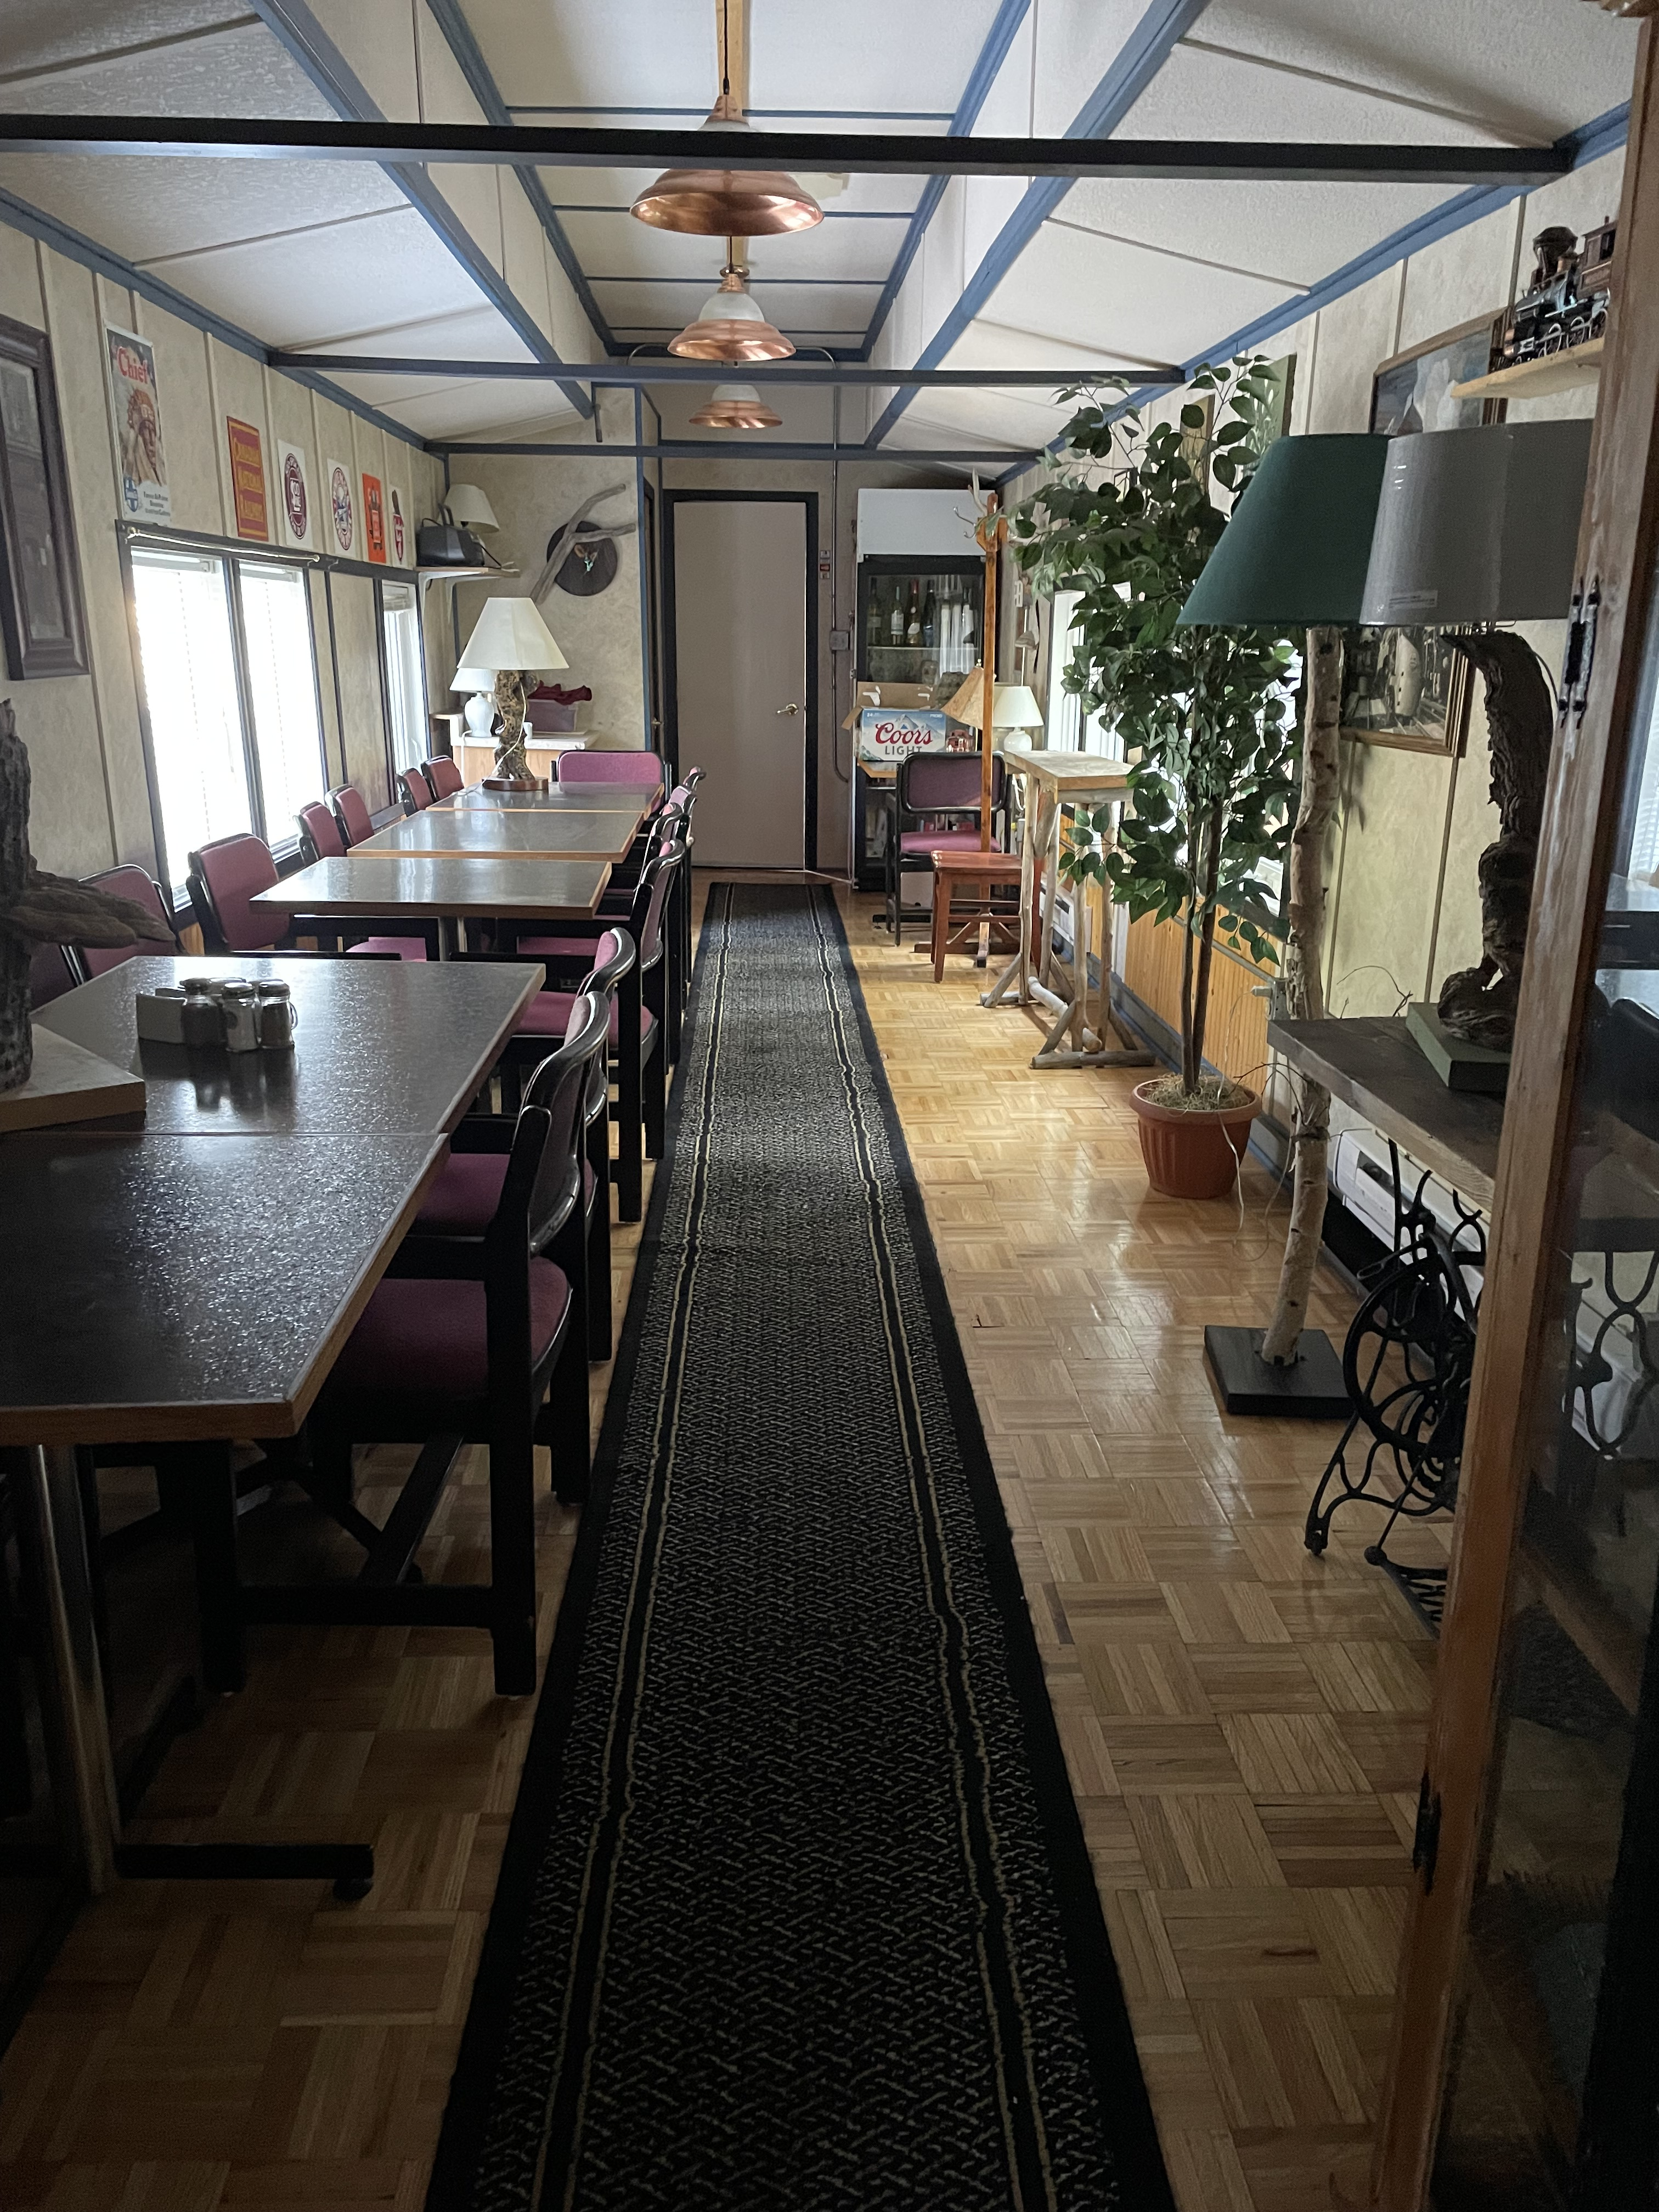
Phase 2
After the donation of the locomotive, the museum discussed the possibility of acquiring a diner to complete the train display. Negotiations for the diner resulted in a term agreement for a total of $100,000.
Payments due:
Jan. 30, 2024 – $33,000
June 30, 2024 - $33,000
Sept. 30, 2024 – $34,000
Transportation of the diner to Sexsmith from Tofield is being donated by RB Oilfield and Shane Chilson.
Cranes to load the diner and trucks onto the transport vehicles are required at a cost to the museum. Quotes received include: Revolution Crane $6,091.31 & Oil City Crane Service $13,134.50.
Total Estimated Cost: $138,525
Total Estimated Donations: $ 37,000

Slide 8
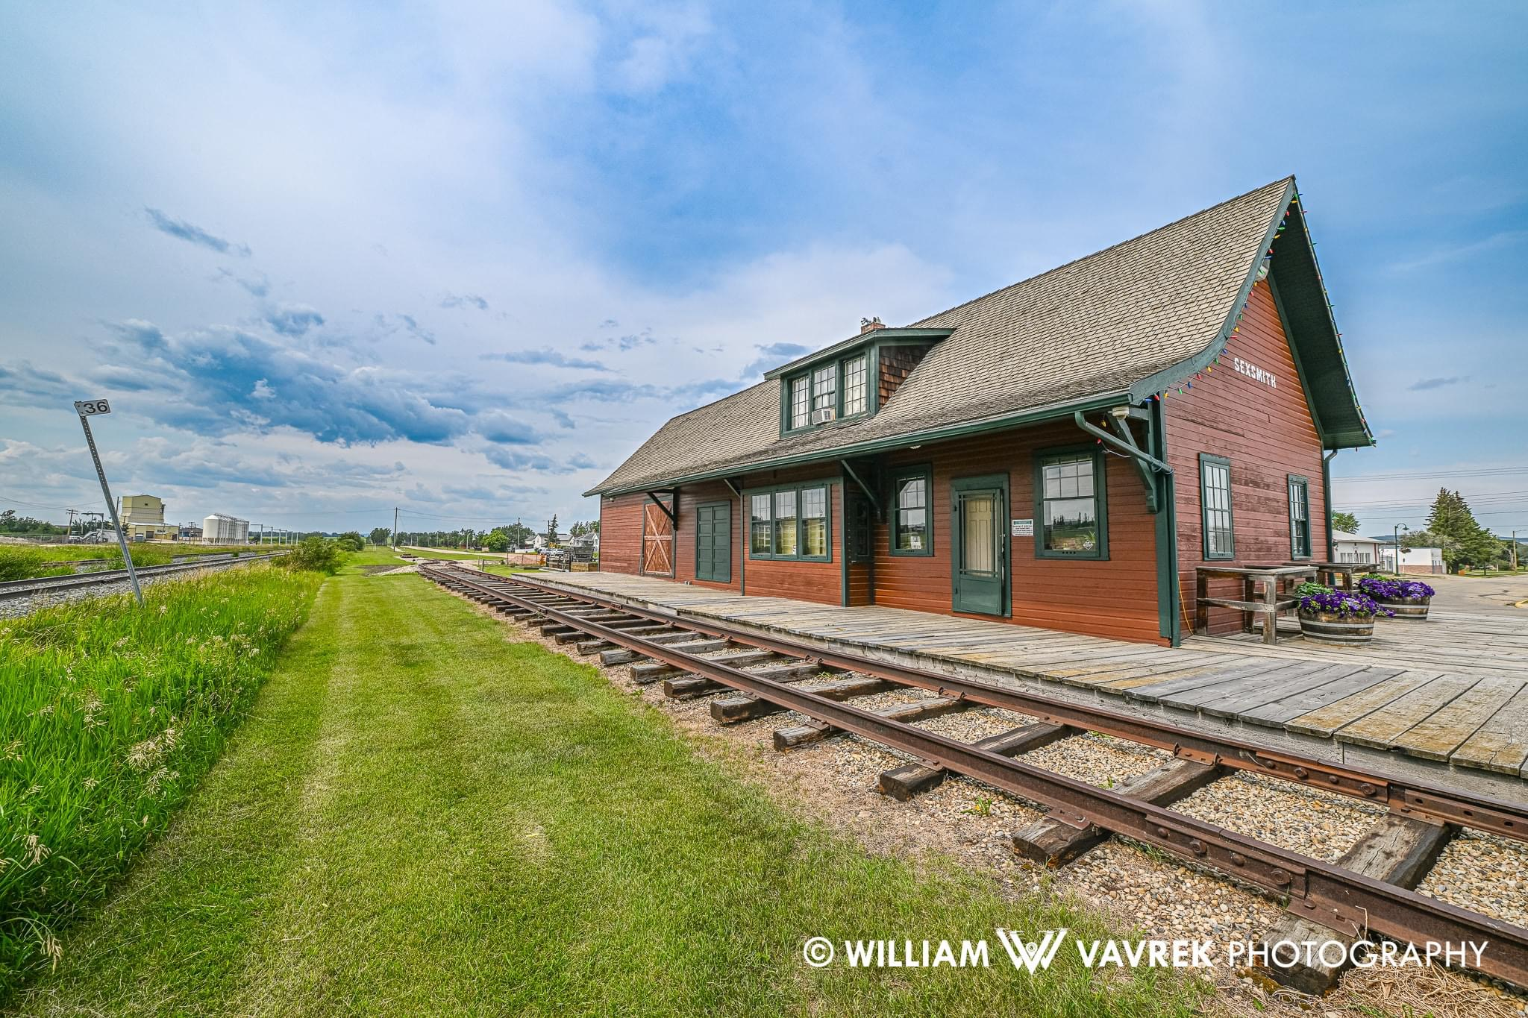
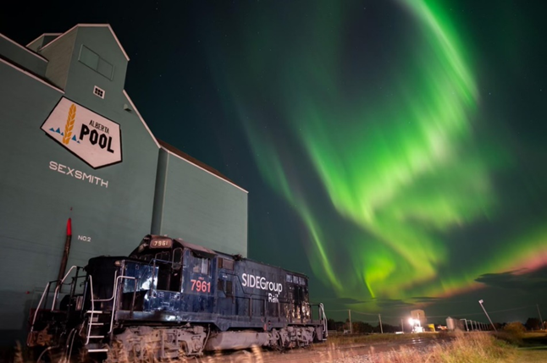
Phase 3
Once the diner is in place, we will undertake the addition of artifacts, dining furniture and an education centre.
The boardwalk will require extension and stairs in and out of the diner.
New exterior paint for all 3 train cars (Locomotive, diner and caboose) will be completed.
Signage for recognition of donations and gifts in kind will be erected.
Total Estimated Cost: $90,000
Total Estimated Donations: TBD

Slide 9
Timeline

Slide 10
Timeline
Painting of cars, signage & exhibit preparation
Oct 2021
Locomotive donated by Al Side
Oct 2023
Siderail Extension completed
Oct 2023
Terms of Agreement reached for purchase of diner
Apr/May 2024
Transport of diner to Sexsmith & shuffling cars onto the siderail
June 2025

Slide 11
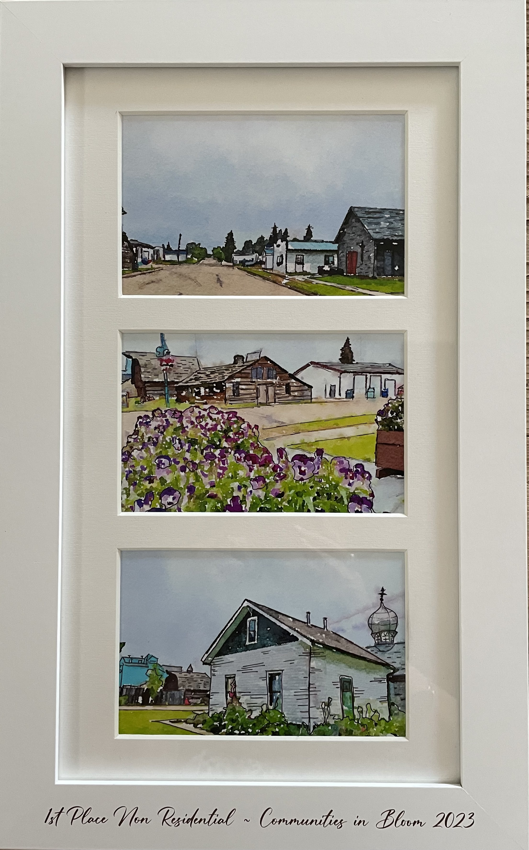
County & Community Benefits
F
The Sexsmith Train Project stands to enrich not only the museum but also the Town of Sexsmith and its surrounding areas, extending its positive impact to the County of Grande Prairie. Upon completion, this ambitious endeavor is poised to significantly boost tourism by virtue of its distinctive nature. As the sole comprehensive train display north of Edmonton, the project is set to become a regional attraction, drawing visitors eager to experience its unique historical and cultural significance. This influx of tourism promises economic benefits for local businesses, creating a ripple effect that extends beyond the immediate vicinity. The Sexsmith Train Project emerges as a beacon of distinction, promising to elevate the region's appeal and establish itself as a noteworthy destination within Alberta.
Total Project Cost: $ 397,631.88
Project Donations/Gifts in Kind: $ 205,394.98

Slide 12
Summary
The Sexsmith & District Museum Society is confident that the Sexsmith Train Project will be a mutually beneficial endeavor, enriching both our local community and its historical legacy. Beyond its local impact, the project has the potential to attract visitors, contributing to the cultural and economic vibrancy of our town and area. We appreciate your recognition of the significance of this initiative and eagerly anticipate the possibility of bringing this unique project to fruition with your support.

Slide 13
Thank you
Lynda Drysdale Fundraising Chairperson Sexsmith & District Museum Society

